Slide 1

P1 Presentation
public class TeamD
Nick Cunningham
Dakota Golightly
Victor Mumford
Sai Donepudi

Slide 2
Team Intro
Nick Cunningham – Future Embedded Systems Engineer
Dakota Golightly – Scrum Master
Victor Mumford – Hopeful VR Developer
Sai Donepudi – Aspiring Software Developer

Slide 3
Overview
Description of Omega Chess
Project Progress
Summary
User Stories Overview
Class Diagram
Kanban Board
Scrum Ceremony Output

Slide 4
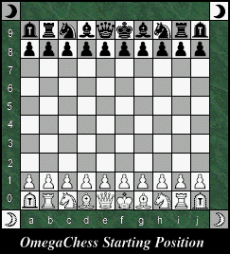
Description of Omega Chess
Omega Chess is much like standard chess, but with these key differences:
The board is 10x10 (standard chess is 8x8), but also with four additional corner squares.
There are two new units: the wizard, and the champion.
The wizard can either move to diagonal squares, or move in a 3x1 L shape, much like the Knight’s 2x1 L.
The champion can move 1-2 spaces in the cardinal directions, or exactly two spaces in the diagonal directions.
There are two of these new units per side. The Champions are put in the extra column spaces next to the Rooks, and the Wizards are put in the extra corner spaces.
Pawns can move 1-3 spaces forward on their first turn instead of 1-2 spaces.
Image source: https://www.chessvariants.com/large.dir/omega/rules.html

Slide 5
Project Progress
P1 was mostly about project setup and planning
Implemented Scrum methodology for development
Deliverables
User stories and tasks
Kanban board
Class diagram and CRC cards
Output of Scrum ceremonies
Implemented code base utilizing Spring Boot/Maven and React

Slide 6
User Stories
User stories were created from the transcript provided in the P1 brief and discussions with the Product Owner
User Stories
“As a user, I would like to be able to”:
Register for an account
Login to my account
Create a new match
Invite other users to my match
View my ongoing matches
See the board of one of my matches
Make a move
Quit an ongoing match
View my user profile
View my match history
Logout of my account
Delete my account

Slide 7
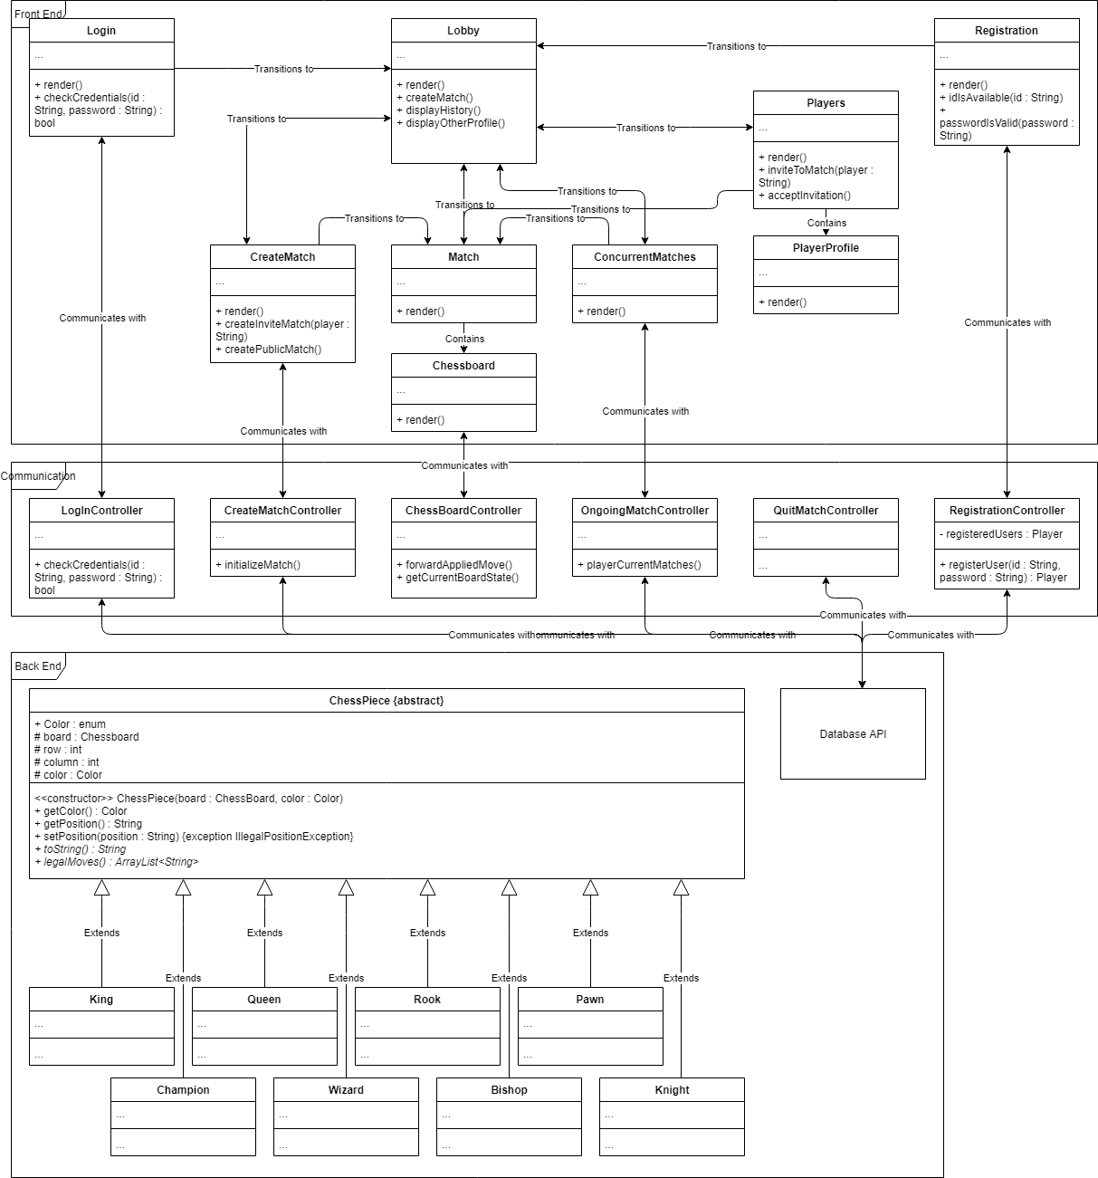
Class Diagram
Visual depiction of class interactions
Describes the functions of the system and its components

Slide 8
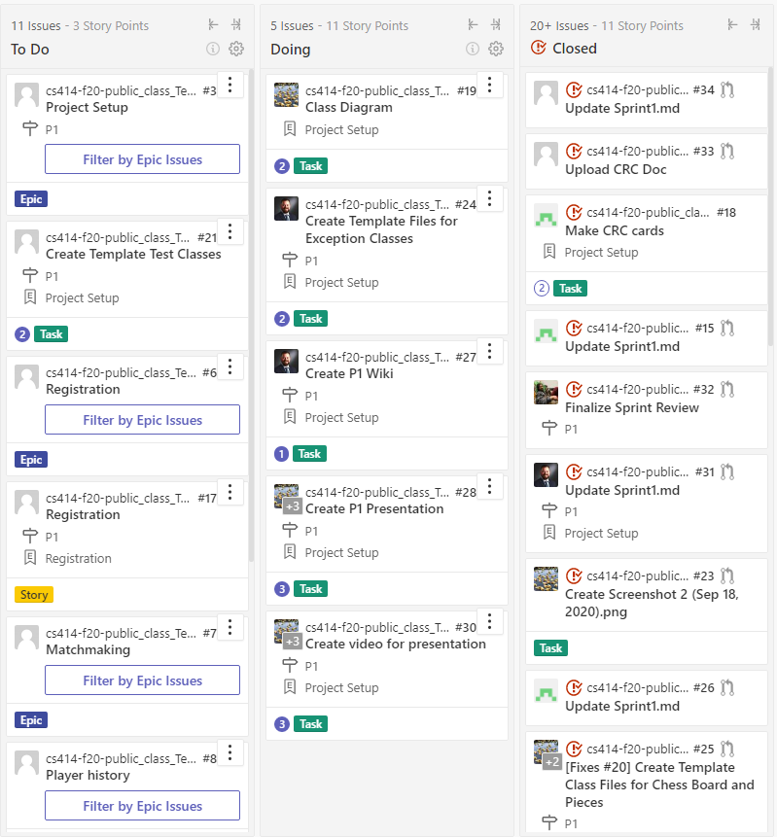
Kanban board
Used to track task status
Includes all epics chose for current sprint
Implemented using ZenHub

Slide 9
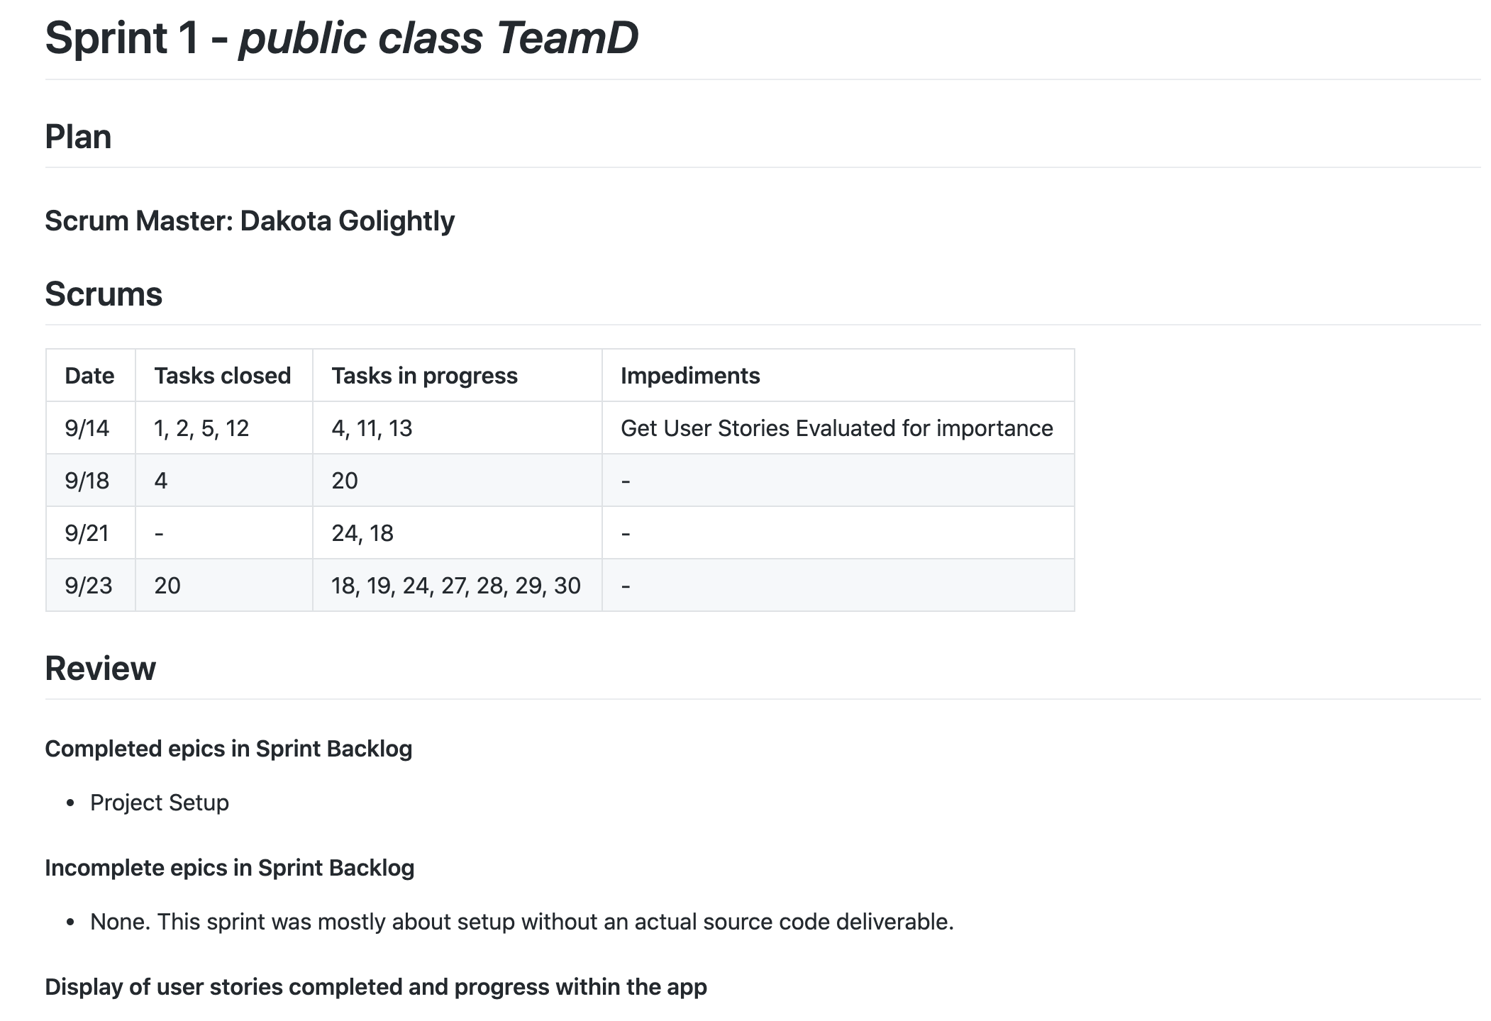
Scrum Ceremonies
Tracked via sprint1.md document
Include Scrum meetings 3x per week, Sprint planning, Sprint review, and Sprint retrospective
Retrospective Takeaways
Schedule conflicts posed early issues but were resolved
IDE-agnostic development environment
Lots of learning around project setup

Slide 10
What’s Next
Use user stories identified in this Sprint to complete backlog for the remainder of the semester
Begin development in previously created code base
Continue to utilize scrum

